Slide 1
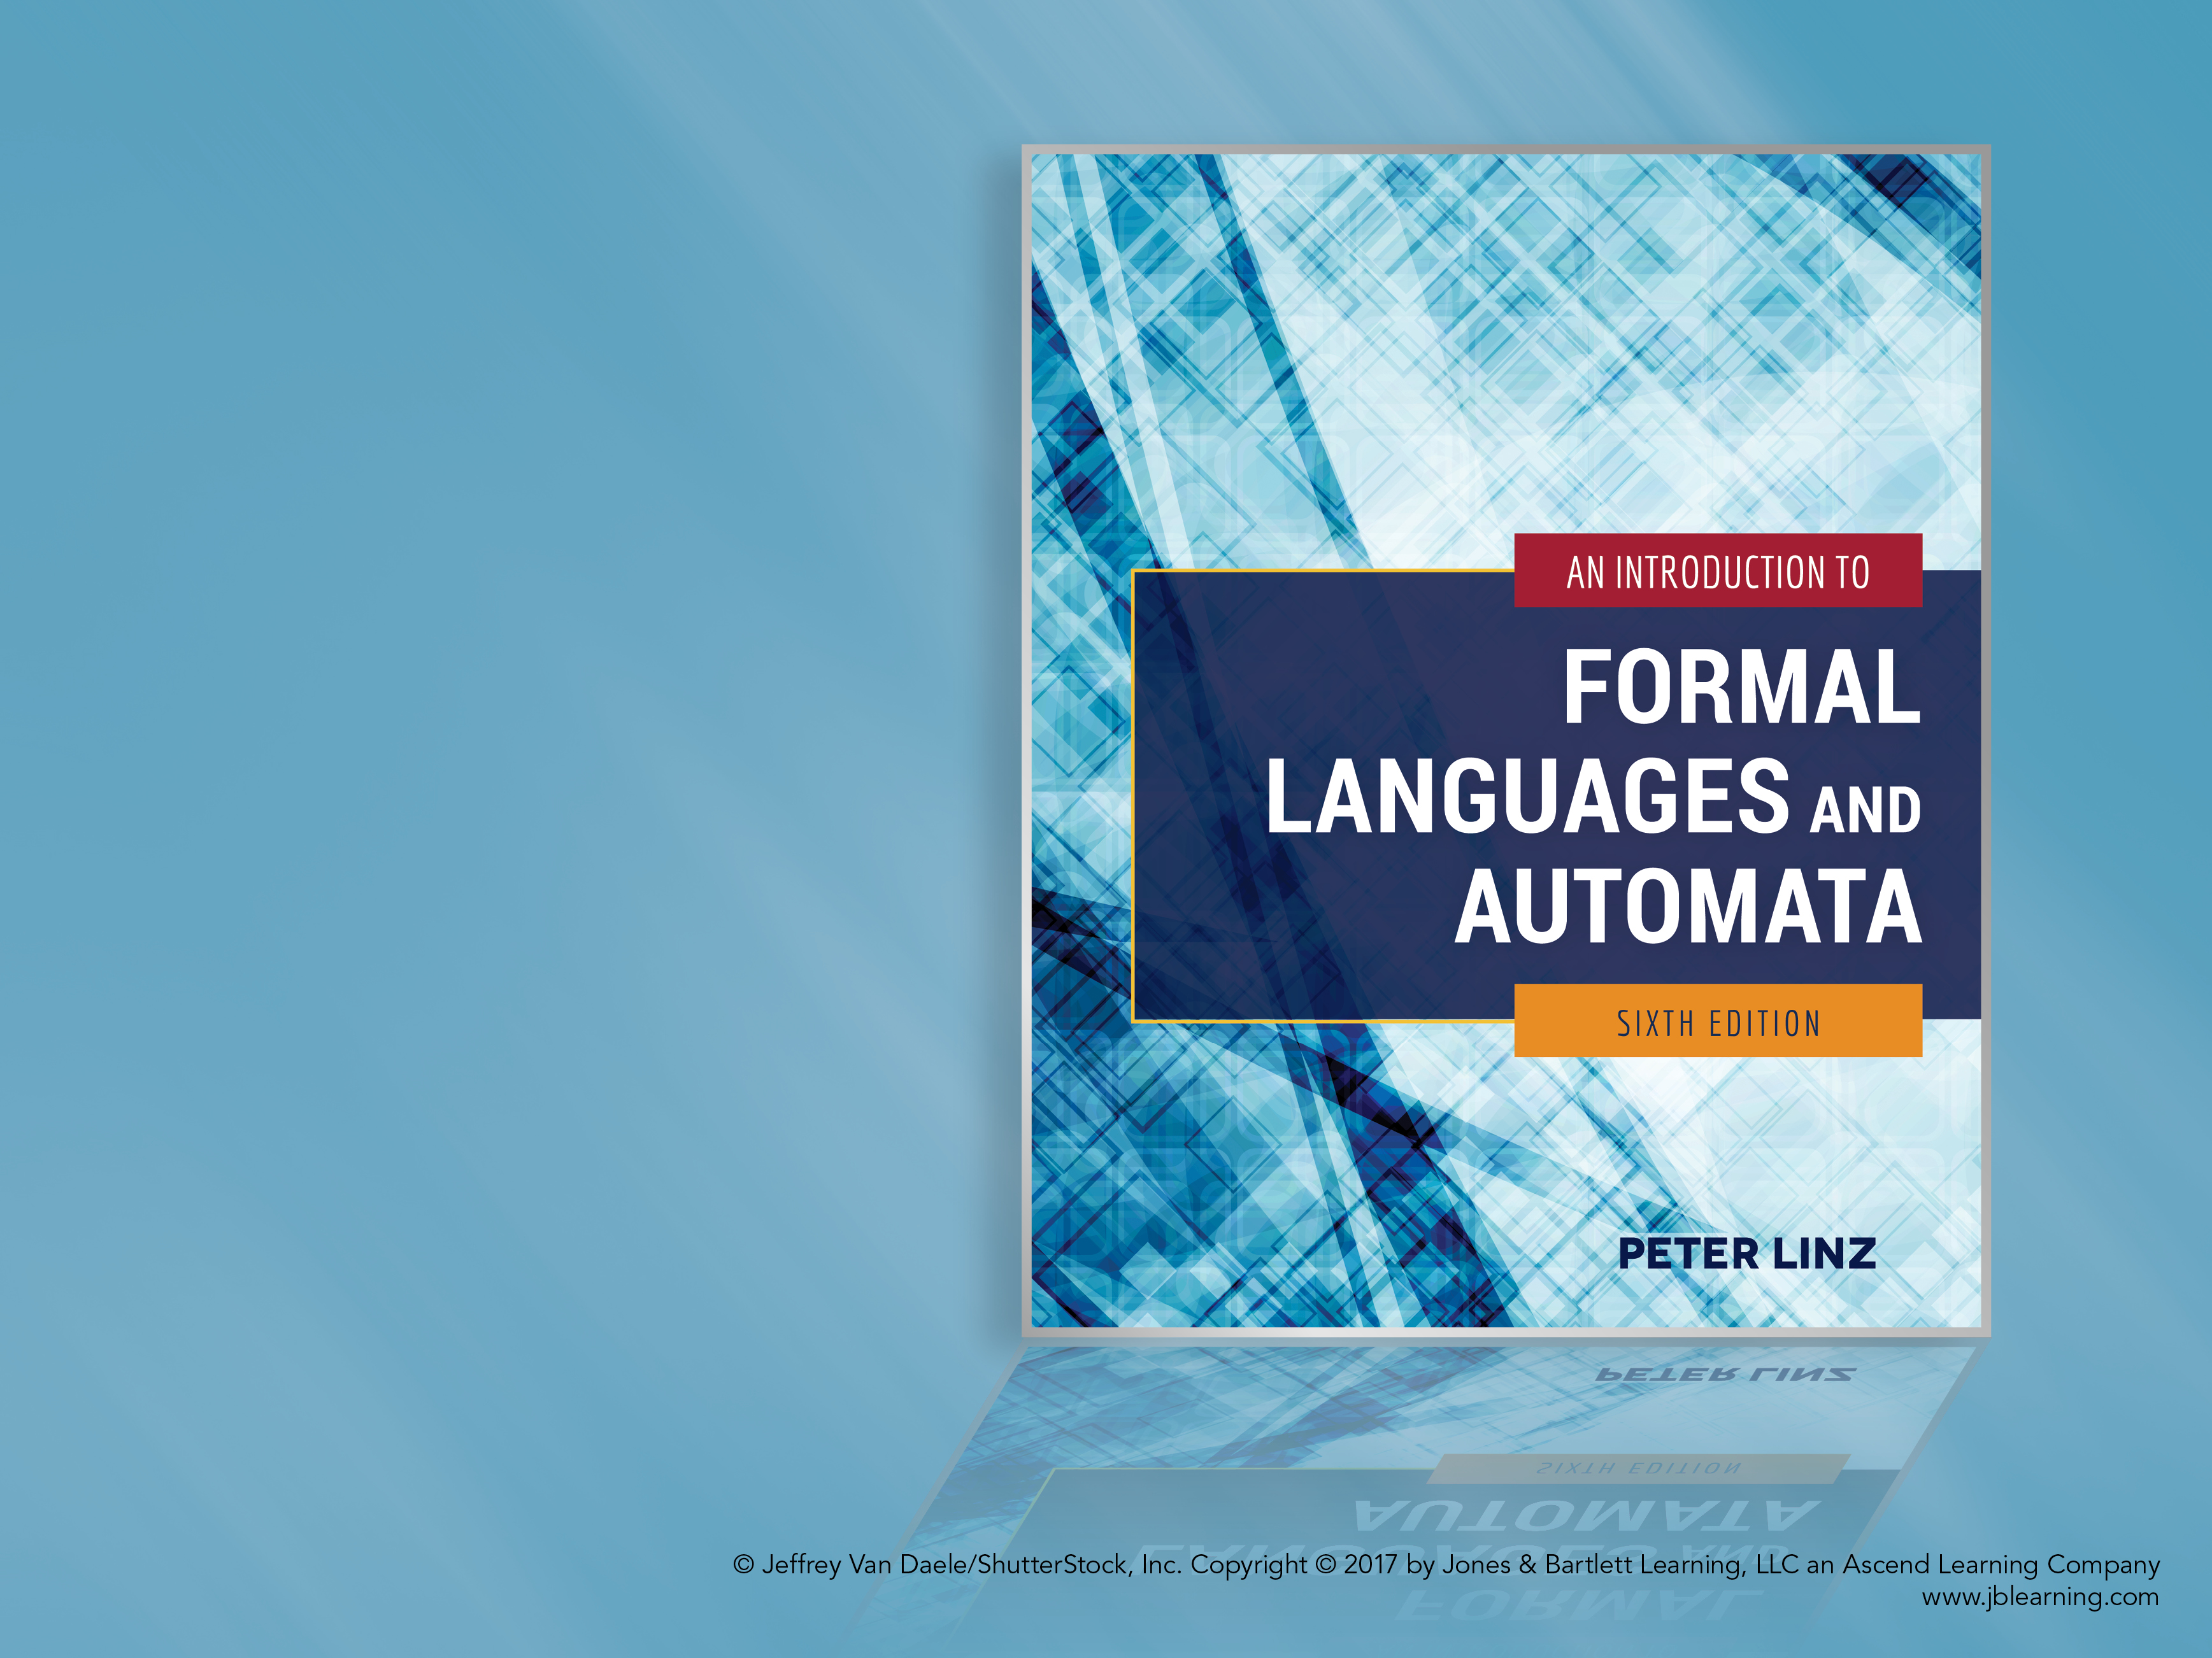
Chapter 11
A HIERARCHY OF FORMAL LANGUAGES AND AUTOMATA

Slide 2
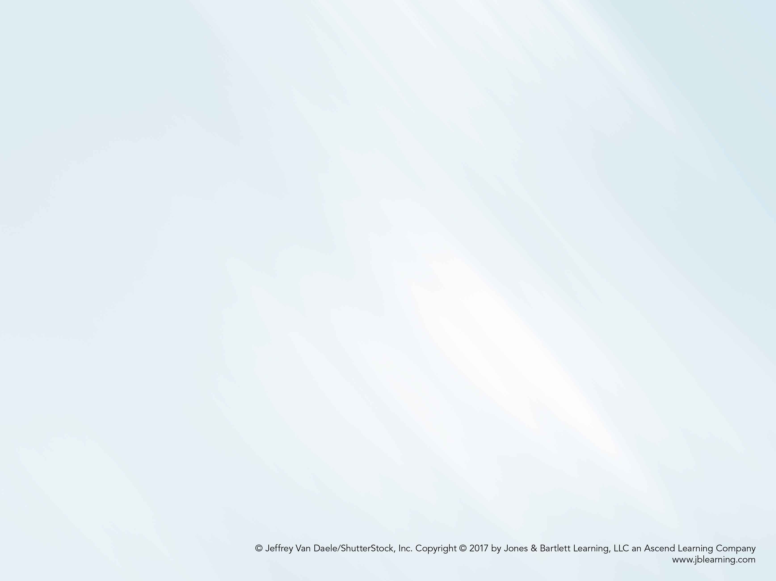
Learning Objectives At the conclusion of the chapter, the student will be able to:
Explain the difference between recursive and recursively enumerable languages
Describe the type of productions in an unrestricted grammar
Identify the types of languages generated by unrestricted grammars
Describe the type of productions in a context sensitive grammar
Give a sequence of derivations to generate a string using the productions in a context sensitive grammar
Identify the types of languages generated by context-sensitive grammars
Construct a context-sensitive grammar to generate a particular language
Describe the structure and components of the Chomsky hierarchy

Slide 3
Recursive and Recursively Enumerable Languages
A language L is recursively enumerable if there exists a Turing machine that accepts it (as we have previously stated, rejected strings cause the machine to either not halt or halt in a nonfinal state)
A language L is recursive if there exists a Turing machine that accepts it and is guaranteed to halt on every valid input string
In other words, a language is recursive if and only if there exists a membership algorithm for it

Slide 4
Languages That Are Not Recursively Enumerable
Theorem 11.1 states that, for any nonempty alphabet, there exist languages not recursively enumerable
One proof involves a technique called diagonalization, which can be used to show that, in a sense, there are fewer Turing Machines than there are languages
More explicitly, Theorem 11.3 describes the existence of a recursively enumerable language whose complement is not recursively enumerable
Furthermore, Theorem 11.5 concludes that the family of recursive languages is a proper subset of the family of recursively enumerable languages

Slide 5
Unrestricted Grammars
An unrestricted grammar has essentially no restrictions on the form of its productions:
Any variables and terminals on the left side, in any order
Any variables and terminals on the right side, in any order
The only restriction is that λ is not allowed as the left side of a production
A sample unrestricted grammar has productions
S → S₁B
S₁ → aS₁b
bB → bbbB
aS₁b → aa
B → λ

Slide 6
Unrestricted Grammars and Recursively Enumerable Languages
Theorem 11.6: Any language generated by an unrestricted grammar is recursively enumerable
Theorem 11.7: For every recursively enumerable language L, there exists an unrestricted grammar G that generates L
These two theorems establish the result that unrestricted grammars generate exactly the family of recursively enumerable languages, the largest family of languages that can be generated or recognized algorithmically

Slide 7
Context-Sensitive Grammars
In a context-sensitive grammar, the only restriction is that, for any production, length of the right side is at least as large as the length of the left side
Example 11.2 introduces a sample unrestricted grammar with productions
S → abc | aAbc
Ab → bA
Ac → Bbcc
bB → Bb
aB → aa | aaA

Slide 8
Characteristics of Context-Sensitive Grammars
An important characteristic of context-sensitive grammars is that they are noncontracting, in the sense that in any derivation, the length of successive sentential forms can never decrease
These grammars are called context-sensitive because it is possible to specify that variables may only be replaced in certain contexts
For instance, in the grammar of Example 11.2, variable A can only be replaced if it is followed by either b or c

Slide 9
Context-Sensitive Languages
A language L is context-sensitive if there is a context-sensitive grammar G, such that either L = L(G) or L = L(G) ∪ { λ }
The empty string is included, because by definition, a context-sensitive grammar can never generate a language containing the empty string
As a result, it can be concluded that the family of context-free languages is a subset of the family of context-sensitive languages
The language { a^{n}b^{n}c^{n}: n ≥ 1 } is context-sensitive, since it is generated by the grammar in Example 11.2

Slide 10
Derivation of Strings Using a Context-Sensitive Grammar
Using the grammar in Example 11.2, we derive the string aabbcc
S ⇒ aAbc
⇒ abAc
⇒ abBbcc
⇒ aBbbcc
⇒ aabbcc
The variables A and B are effectively used as messengers:
an A is created on the left, travels to the right of the first c, where it creates another b and c, as well as variable B
the newly created B is sent to the left in order to create the corresponding a

Slide 11
Context-Sensitive Languages and Linear Bounded Automata
Theorem 11.8 states that, for every context-sensitive language L not including λ, there is a linear bounded automaton that recognizes L
Theorem 11.9 states that, if a language L is accepted by a linear bounded automaton M, then there is a context-sensitive grammar that generates L
These two theorems establish the result that context-sensitive grammars generate exactly the family of languages accepted by linear bounded automata, the context-sensitive languages

Slide 12
Relationship Between Recursive and Context-Sensitive Languages
Theorem 11.10 states that every context-sensitive language is recursive
Theorem 11.11 maintains that some recursive languages are not context-sensitive
These two theorems help establish a hierarchical relationship among the various classes of automata and languages:
Linear bounded automata are less powerful than Turing machines
Linear bounded automata are more powerful than pushdown automata

Slide 13
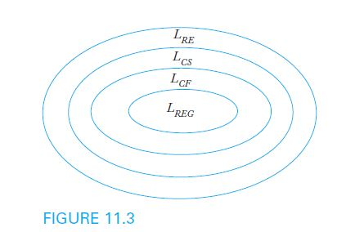
The Chomsky Hierarchy
The linguist Noam Chomsky summarized the relationship between language families by classifying them into four language types, type 0 to type 3
This classification, which became known as the Chomsky Hierarchy, is illustrated in Figure 11.3

Slide 14
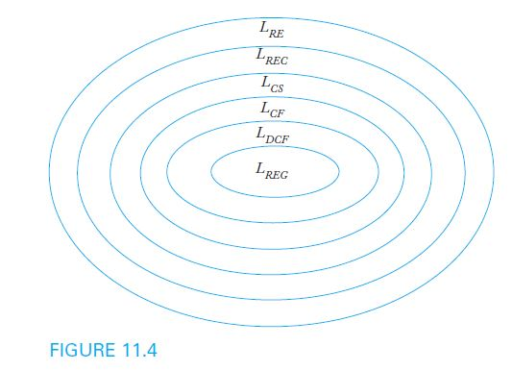
An Extended Hierarchy
We have studied additional language families and their relationships to those in the Chomsky Hierarchy
By including deterministic context-free languages and recursive languages, we obtain the extended hierarchy in Figure 11.4

Slide 15
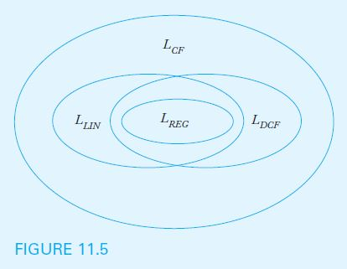
A Closer Look at the Family of Context- Free Languages
Figure 11.5 illustrates the relationships among various subsets of the family of context-free languages: regular (L_{REG}), linear (L_{LIN}), deterministic context-free (L_{DCF}), and nondeterministic context-free (L_{CF})

